Slide 1

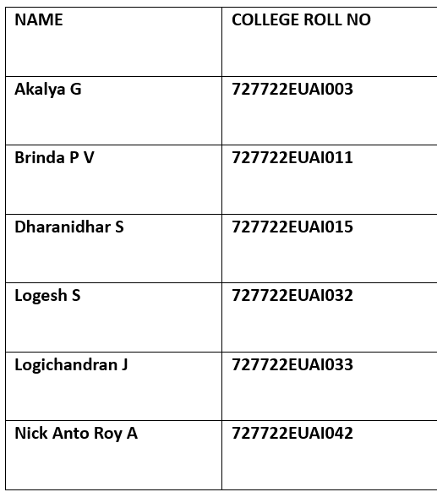
Cognizant Hackathon 2025
SRI KRISHNA COLLEGE OF ENGINEERING AND TECHNOLOGY
USE CASE - 3
PREDICTING MEDICAL EQUIPMENT FAILURE
BATCH – 01

Slide 2
OUR MENTOR TEAM
COGNIZANT MENTOR
R . Arul Prakash
9894812475
ArulPrakash.R2@cognizant.com
COGNIZANT
COLLEGE MENTOR
Mr. G. S. Pugalendhi
9842465747
pugalendhigs@skcet.ac.in
SRI KRISHNA COLLEGE OF ENGINEERING AND TECHNOLOGY

Slide 3
PROBLEM STATEMENT
PREDICTING MEDICAL EQUIPMENT FAILURE
Predicting medical device failure is crucial for ensuring patient safety, minimizing downtime, and reducing maintenance costs. This use case involves leveraging data analytics and machine learning to predict potential failures of medical devices before they occur.

Slide 4
OBJECTIVE
Develop a machine learning algorithm that can predict medical device failures, enabling proactive interventions and maintenance. The data consist of large collection of recalls, safety alerts and field safety notices about medical devices distributed worldwide.

Slide 5
PROPOSED IDEA
We propose a machine learning–based predictive system for medical device risk analysis. Unlike rule-based methods, our model learns hidden patterns from recalls, alerts, and reports to predict device failures in advance, enabling proactive interventions and improving patient safety.

Slide 6
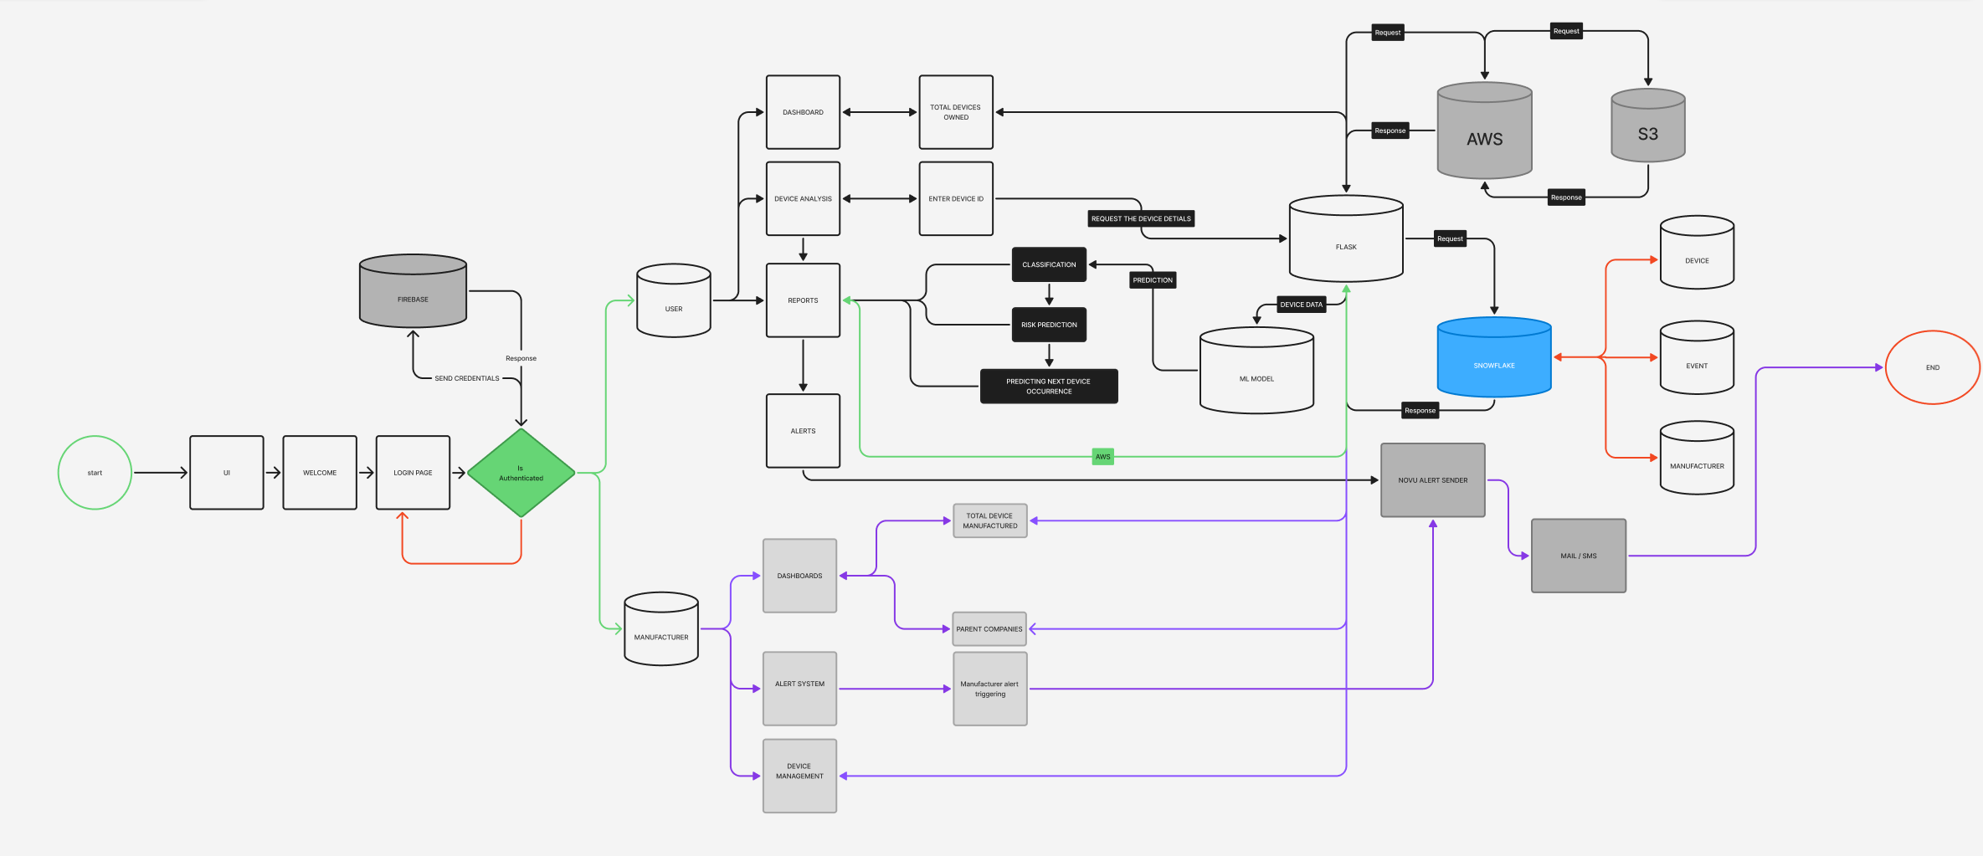
ARCHITECTURE DIAGRAM
(click here)

Slide 7

PROJECT DESCRIPTION
The project involves preprocessing medical device event data (cleaning, regex-based normalization, and deduplication), followed by the creation of manufacturer and device datasets.
Machine learning models were developed for class prediction and risk assessment, using algorithms such as Logistic Regression, Decision Tree, and Random Forest.
The models were integrated with Snow Flake and AWS and tested for time-based predictions.
The system generates risk percentages, and predictive alerts, enabling stakeholders to take proactive preventive actions.

Slide 8
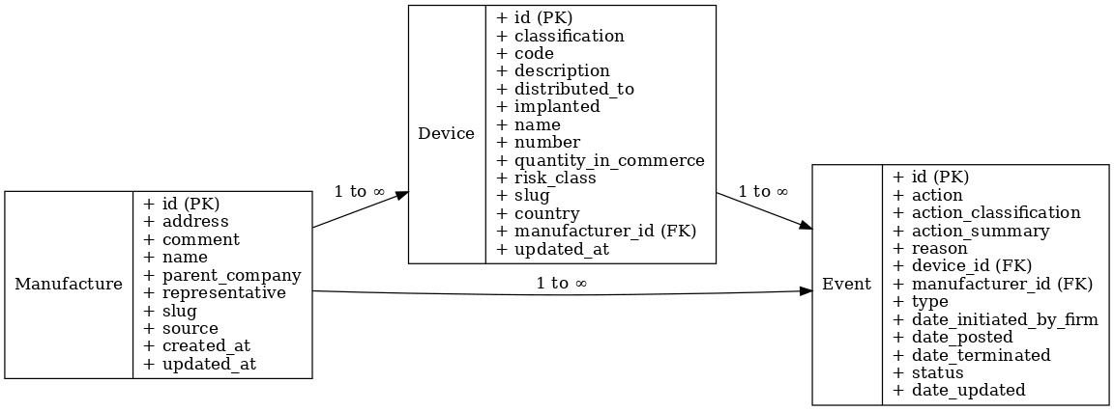
DATASETS GIVEN
Device.csv (118249 rows)
Event.csv( 124970 rows)
Manufacture.csv( 31827rows)

Slide 9
MODEL DESCRIPTION
Model | Overview | Preprocessing Applied | Strengths | Limitations | Performance
Logistic Regression | Baseline model to estimate probability of device failure/recall being critical or non-critical | - One-hot encoding of categorical variables (device type, manufacturer, country) - Scaling of numerical features (recall duration) | - Simple & interpretable - Fast to train & test - Good baseline | - Misses complex non-linear patterns - Limited to linear dependencies | Accuracy: 70% F1: 0.70
Decision Tree | Splits dataset into branches based on feature conditions for risk classification | - Label encoding for categorical features - No scaling needed | - Highly interpretable decision paths - Captures non-linear relationships better than Logistic Regression | - Prone to overfitting - Moderate performance vs. ensembles | Accuracy: 72% F1: 0.78
Random Forest | Ensemble of decision trees combining multiple predictions for accuracy and robustness | - Label encoding of categorical variables - Minimal feature scaling required | - Highest accuracy & robust - Handles noise, missing values, imbalance well - Provides feature importance | - Longer training time - Less interpretable than a single tree (though feature importance helps) | Accuracy: 82% F1: 0.80

Slide 10


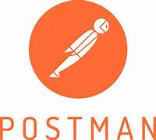





TECHNICAL SUPPORTS - SOFTWARE
FRONT – END DEVELOPMENT
REACT
HTML / CSS
API DEVELOPMENT
CLOUD
STORAGE

Slide 11
EXPECTED OUTCOMES
Early Failure Prediction → Identify high-risk devices before they fail.
Alerts & Reports → Notifications to manufacturers for proactive action.
Improved Decision-Making → Regulators(Health Authorities) and hospitals can prioritize maintenance and recalls.
Cost Reduction → Minimized downtime and recall expenses.
Enhanced Patient Safety → Reduced chances of harmful incidents.
FUTURE ENHANCEMENTS
Implementation of XG BOOST
Automated Alerts and Reports
Real time prediction
Textual Data Handling (NLP)

Slide 12
BENEFICIARIES
Patients – safer treatments, reduced risks.
Hospitals/Device Administrators – proactive maintenance planning, less downtime.
Manufacturers – early risk alerts, better reputation management, reduced recall costs.
Regulatory Bodies – faster compliance checks, global device monitoring.
ESTIMATED COST
Total Cost
Monthly: ~$140–$160
Yearly: ~$1,700–$1,900

Slide 13
Service | Optimized Choice | Monthly Cost (USD) | Yearly Cost (USD)
React Frontend | S3 + CloudFront | $3 | $36
Flask + ML API | AWS Lambda (or 1× t3.medium EC2 if needed) | $10 (Lambda) / $35 (EC2) | $120 / $420
Reports Storage | S3 (2 GB/month) | $1 | $12
Snowflake Storage | 20 GB | $20 | $240
Snowflake Compute | Auto-suspend, light workloads | $100 | $1,200
Monitoring | CloudWatch basic | $5 | $60
Domain (Route53) | 1 domain | $0.50 | $6
Monthly: ~$140–$160
Yearly: ~$1,700–$1,900

Slide 14
DOCUMENTATIONS
HACKATHON PROGRESS DOCUMENTATION
INDIVIDUAL CONTRIBUTIONS
MODEL EVALUVATION
TESTING
GITHUB UPDATES (click here)
DAY WISE UPDATES FROM DAY 1 TO 12
READ ME UPDATES
GITHUB CONTRIBUTORS
BRINDA PV
LOGESH S
NICK ANTO ROY A

Slide 15
Demo
&
Q/A

Slide 16
THANK YOU

